Slide 1
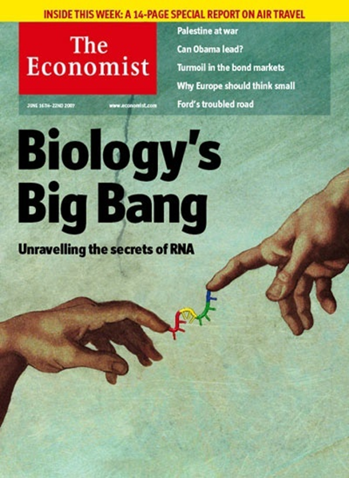
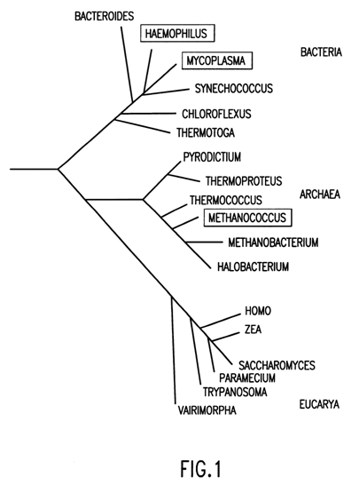
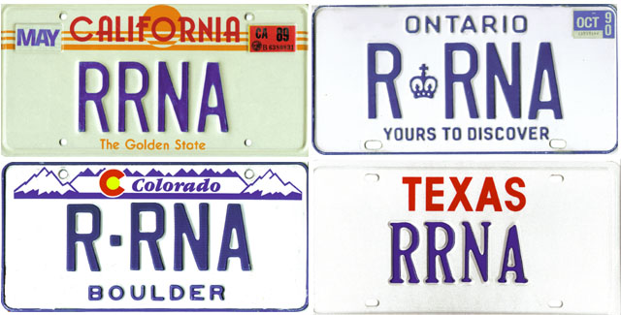
Capturing the Structural, Functional, and Evolutionary Constraints of RNA Molecules with rCAD - an RNA Comparative Analysis Database
IEEE/MSR eScience Conference December 5 – 8, 2011 Stockholm, Sweden
The Gutell Lab @ The University of Texas at Austin

Slide 2
Major Topics
RNA Science
Importance of RNA, major paradigm shift
RNA structure prediction and Comparative analysis
RNA Comparative Analysis Database (rCAD)
Multiple Dimensions of Data
Sophisticated Schema for data management and analysis
Discoveries and Applications possible with rCAD
Alignment editor
CRW Site
Enhanced covariation analysis with Phylogenetic Events Counting (PEC)
Improvements in the template-based alignment
Structural statistics that reveal biases in the distribution of sequences within different structural motifs.
Structural potentials that improve the prediction of an RNA secondary structure from a single sequence (RNA Folding).

Slide 3
Major Topics
RNA Science
Importance of RNA, major paradigm shift
RNA structure prediction and Comparative analysis
RNA Comparative Analysis Database (rCAD)
Multiple Dimensions of Data
Sophisticated Schema for data management and analysis
Discoveries and Applications possible with rCAD
Alignment editor
CRW Site
Enhanced covariation analysis with Phylogenetic Events Counting (PEC)
Improvements in the template-based alignment
Structural statistics that reveal biases in the distribution of sequences within different structural motifs.
Structural potentials that improve the prediction of an RNA secondary structure from a single sequence (RNA Folding).

Slide 4
RNA Science: Importance of RNA
We are in the midst of a major paradigm shift in Biology
RNAs function in the cell was once considered to be involved only in protein synthesis.
Ribosomal RNA and the ribosomal proteins formed the ribosomes, the site of protein synthesis. Transfer RNA brought the proper amino acid to the growing peptide chain, based on its three nucleotide interaction with the messenger RNA. And the messenger RNA encoded the sequence of the protein in its triplet code.
Now RNA is associated with a growing number of functions. This significant paradigm shift is dramatically changing our knowledge of the detailed mechanisms of the cell.
An understanding of the function of these RNAs is directly associated with their higher-order structure.

Slide 5
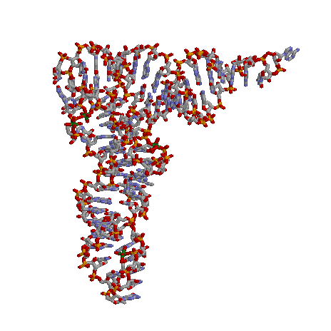
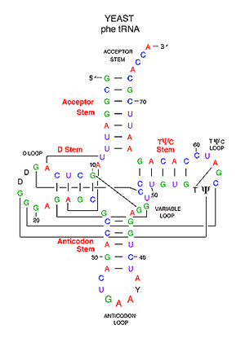
RNA Science: Importance of RNA
While RNA can form simple A:U and G:C base pairings like DNA, RNA has the capacity to form unique three-dimensional structure that can form special chemical structures capable of performing different types of catalysis (like proteins)
3D Structure
Secondary Structure
3D Structure
Secondary Structure
16S rRNA 766-813 NT
Phe tRNA Structure
(S3 protein in T. thermophilus 30S Ribosome)
RNA
Protein

Slide 6
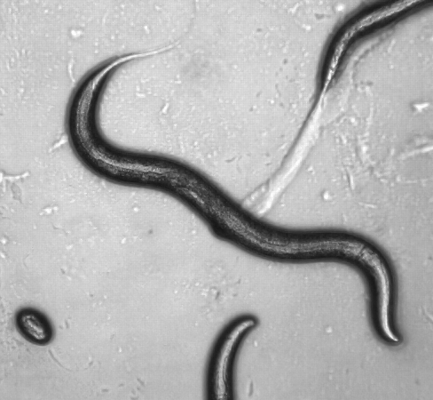
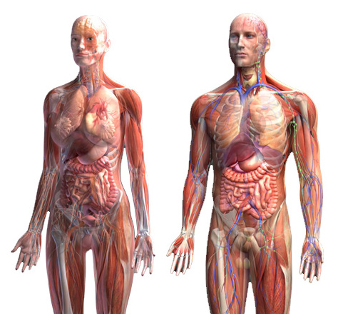
RNA Science: Importance of RNA
While it had been assumed that the complexity of an organism scales with the amount of protein in a cell, we are now beginning to appreciate that the complexity scales with the amount of RNA in the cell. E.g. the human genome has ~30 times more DNA than C. elegans, while the number of protein-coding genes are roughly the same. The vast majority of the genome that is not coding for a protein is transcribed into RNA.
 | C. elegans | Human
Genome Size | 97 mega base pairs | 3,000 mega base pairs
Protein-coding genes | ~20,000 | 20,000 ~ 25,000

Slide 7
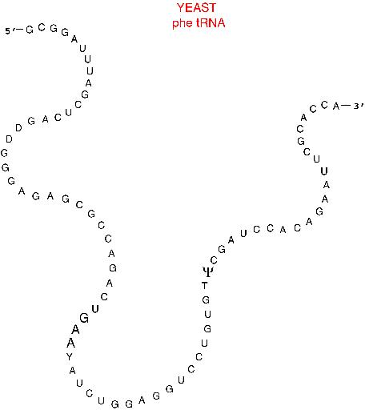
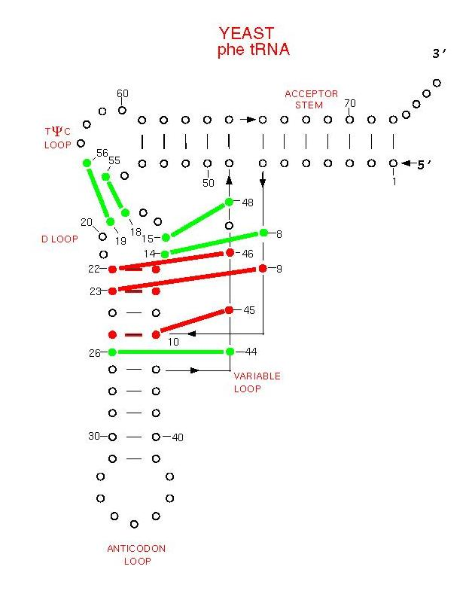
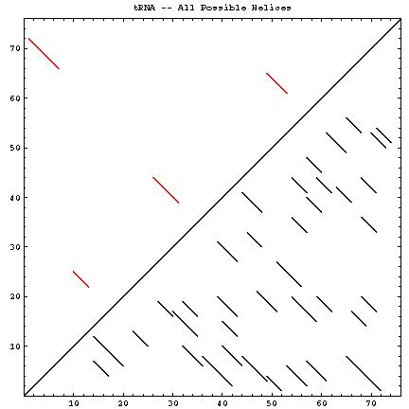
RNA Science: RNA Structure Prediction
Predicting an RNA secondary and tertiary structure from nucleotide sequence
 | tRNA | 16S rRNA | 23S rRNA
# Nucleotides | 76 | 1542 | 2904
# Potential Helices | 37 | 14684 | 51442
# Possible Structures | 2.5 x 10¹⁹ | 4.3 x 10³⁹³ | 6.3 x 10⁷⁴⁰
# Actual Helices | 4 | 58 | 105
Complexity of RNA folding : helices in comparative structure shown in red above the diagonal, all potential helices shown below diagonal

Slide 8
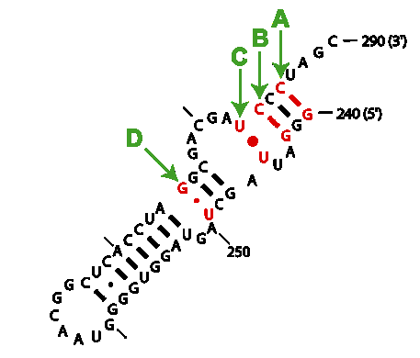
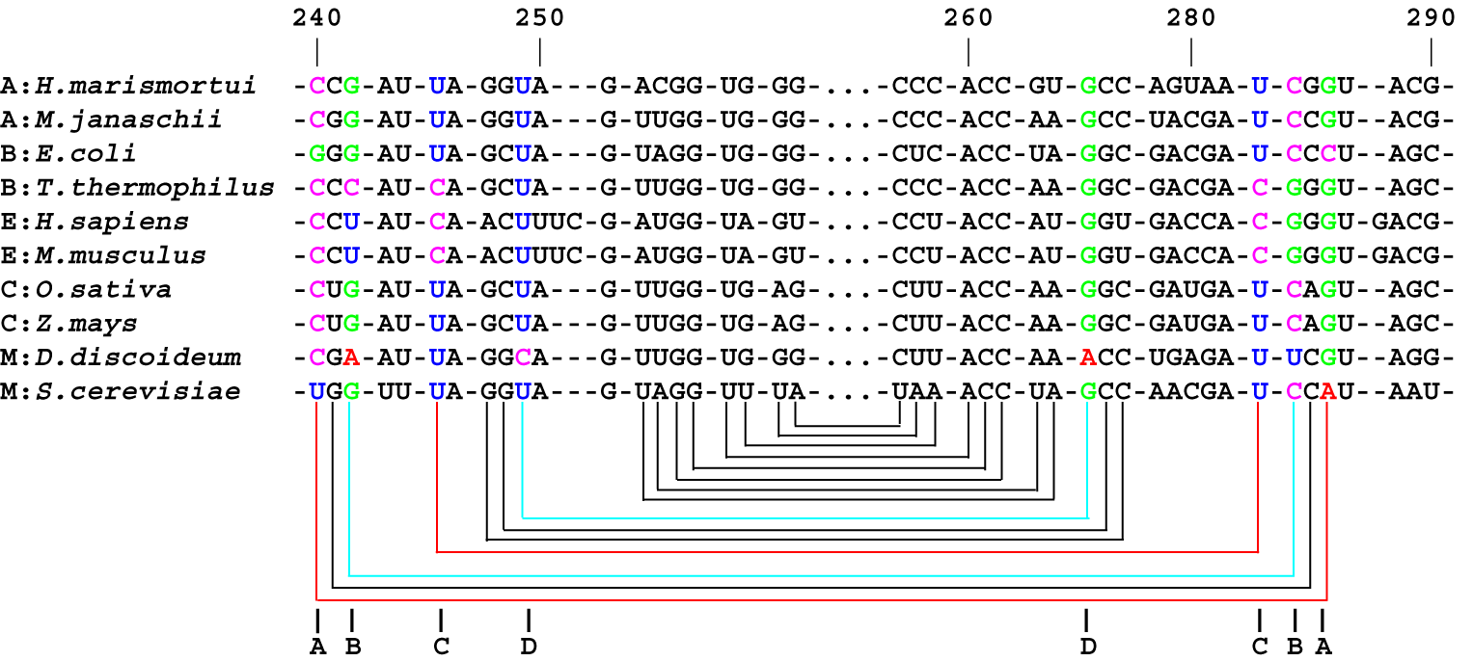
Accuracy of the Comparative Structure Models for rRNA
RNA Science: Comparative Analysis
A
Inferred secondary structure
NT 240 | NT 246
C | G
C | G
G | C
C | G
C | G
C | G
C | G
C | G
C | G
U | A
Crystal structure
Model | Accuracy of Predictions
16S rRNA | 461/476 = 97%
23S rRNA | 779/797 = 98%
TOTAL | 1240/1273 = 97%

Slide 9
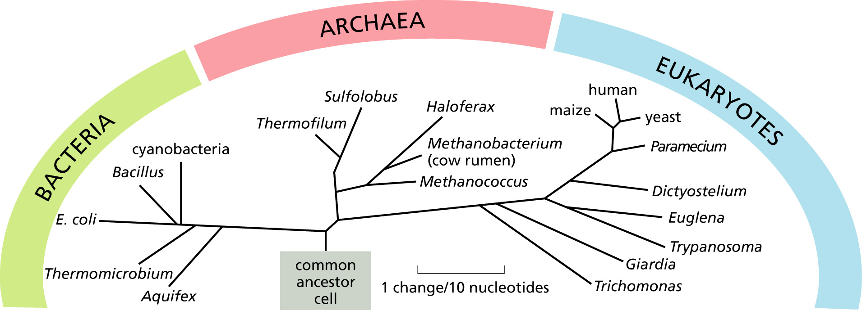
Grand Challenge in Biology:
RNA Science: Comparative Analysis
Determining the phylogenetic/taxonomic relationships for organisms that span the entire tree of life.

Slide 10
RNA Structure: Secondary Structure, Energetics, Base Stacking, and High-Resolution 3D Structure
RNA Science: RNA Structure Prediction

Slide 11
Major Topics
RNA Science
Importance of RNA, major paradigm shift
RNA structure prediction and Comparative analysis
RNA Comparative Analysis Database (rCAD)
Multiple Dimensions of Data
Sophisticated Schema for data management and analysis
Discoveries and Applications possible with rCAD
Alignment editor
CRW Site
Enhanced covariation analysis with Phylogenetic Events Counting (PEC)
Improvements in the template-based alignment
Structural statistics that reveal biases in the distribution of sequences within different structural motifs.
Structural potentials that improve the prediction of an RNA secondary structure from a single sequence (RNA Folding).

Slide 12
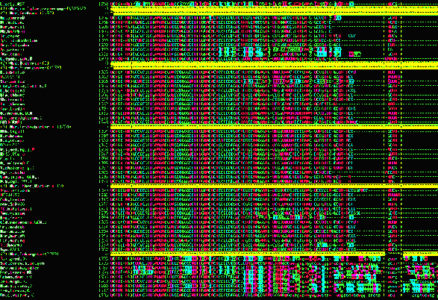
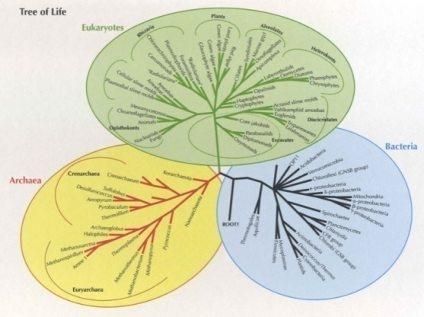
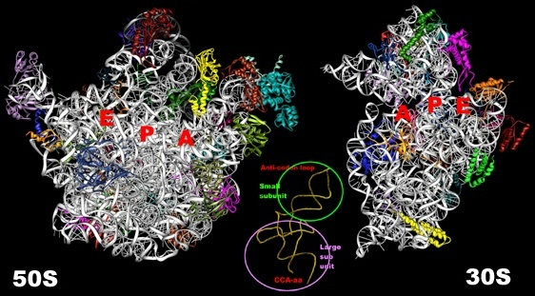
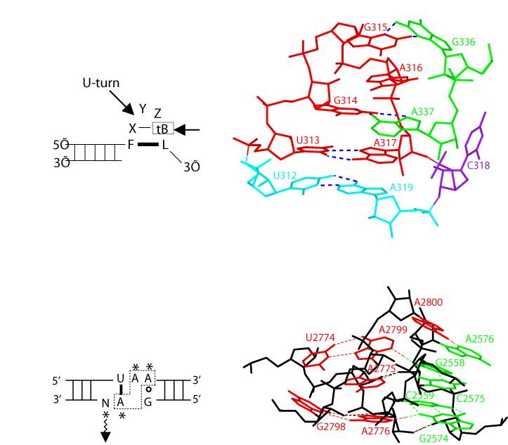
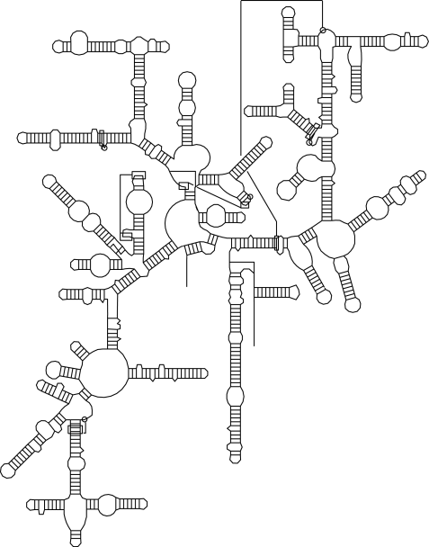
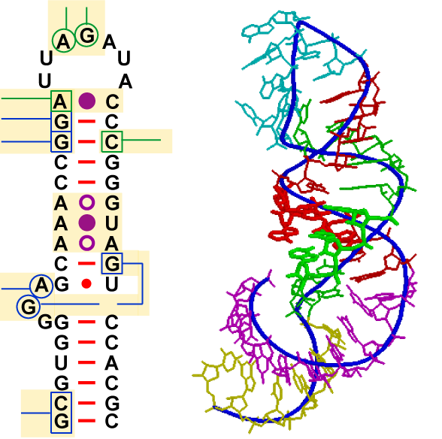
rCAD: Multiple Dimensions of Data
Goal: Integrate Multiple Dimensions of Comparative and Structural Information
Sequence alignment
Phylogenetic tree for organisms across the entire tree of life
High-resolution crystal structure
RNA Secondary structure
Structural motifs
3D structure mapped onto the sec. str. (left)
High resolution 3D str. of sec. str. (right)
Notes:
The algorithm is described in the previous slide, now the problem is how we implement this method.
How to integrate all these information.
1. rCAD schema and relational database
2. More than the repository of data, but also tools and application system

Slide 13
.
rCAD: Multiple Dimensions of Data
This picture of living creatures, as patterns of organization rather than collections of molecules, applies not only to bees and bacteria, butterflies and rain forests, but also to sand dunes and snowflakes, thunderstorms and hurricanes. The nonliving universe is as diverse and as dynamic as the living universe, and is also dominated by patterns of organization that are not yet understood. The reductionist physics and the reductionist molecular biology of the twentieth century will continue to be important in the twenty-first century, but they will not be dominant. The big problems, the evolution of the universe as a whole, the origin of life, the nature of human consciousness, and the evolution of the earth's climate, cannot be understood by reducing them to elementary particles and molecules. New ways of thinking and new ways of organizing large databases will be needed.
The New York Review of Books Vol 54, July 19, 2007
Our Biotech Future By Freeman Dyson

Slide 14
rCAD: Multiple Dimensions of Data
BGI, based in China, is the world’s largest genomics research institute, with 167 DNA sequencers producing the equivalent of 2,000 human genomes a day.
The field of genomics is caught in a data deluge. DNA sequencing is becoming faster and cheaper at a pace far outstripping Moore’s law, which describes the rate at which computing gets faster and cheaper.
That could delay the day when DNA sequencing is routinely used in medicine. In only a year or two, the cost of determining a person’s complete DNA blueprint is expected to fall below $1,000. But that long-awaited threshold excludes the cost of making sense of that data, which is becoming a bigger part of the total cost as sequencing costs themselves decline.
The Human Microbiome Project, which is sequencing the microbial populations in the human digestive tract, has generated about a million times as much sequence data as a single human genome, said C. Titus Brown, a bioinformatics specialist at Michigan State University.
“We believe the field of bioinformatics for genetic analysis will be one of the biggest areas of disruptive innovation in life science tools over the next few years,” Isaac Ro, an analyst at Goldman Sachs, wrote in a recent report.
DNA Sequencing Caught in Deluge of Data The New York Times, December 1, 2011, Andrew Pollack

Slide 15
rCAD: Multiple Dimensions of Data
In a speech given just a few weeks before he was lost at sea off the California coast in January 2007, Jim Gray, a database software pioneer and a Microsoft researcher, sketched out an argument that computing was fundamentally transforming the practice of science.
Dr. Gray called the shift a “fourth paradigm.” The first three paradigms were experimental, theoretical and, more recently, computational science. He explained this paradigm as an evolving era in which an “exaflood” of observational data was threatening to overwhelm scientists. The only way to cope with it, he argued, was a new generation of scientific computing tools to manage, visualize and analyze the data flood.
In essence, computational power created computational science, which produced the overwhelming flow of data, which now requires a computing change. It is a positive feedback loop in which the data stream becomes the data flood and sculptures a new computing landscape.
In computing circles, Dr. Gray’s crusade was described as, “It’s the data, stupid.” It was a point of view that caused him to break ranks with the supercomputing nobility, who for decades focused on building machines that calculated at picosecond intervals.
The New York Times, Dec 15, 2009
A Deluge of Data Shapes a New Era in Computing
By John Markoff

Slide 16
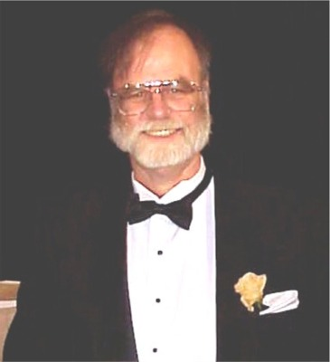
Stuart Ozer - Quote
rCAD: Multiple Dimensions of Data
Our collaboration began in February 2006 when you and your graduate student, Kishore Doshi, approached Microsoft with an extremely complex database problem: how to best represent large-scale […] metadata, sequence alignment, base pair and other structural annotations, and phylogenetic information into a single database system.
The challenge and complexity of this problem were music to our ears here at Microsoft. […] I had recently moved into Jim’s group after spending 5 years on the team that engineered the SQL Server database product, and was eager to tackle challenging computational problems in structural biology.
[…] I expect that our ongoing work together will continue to prove to be extremely fruitful for both your lab and Microsoft.
--Stuart Ozer (2007)

Slide 17
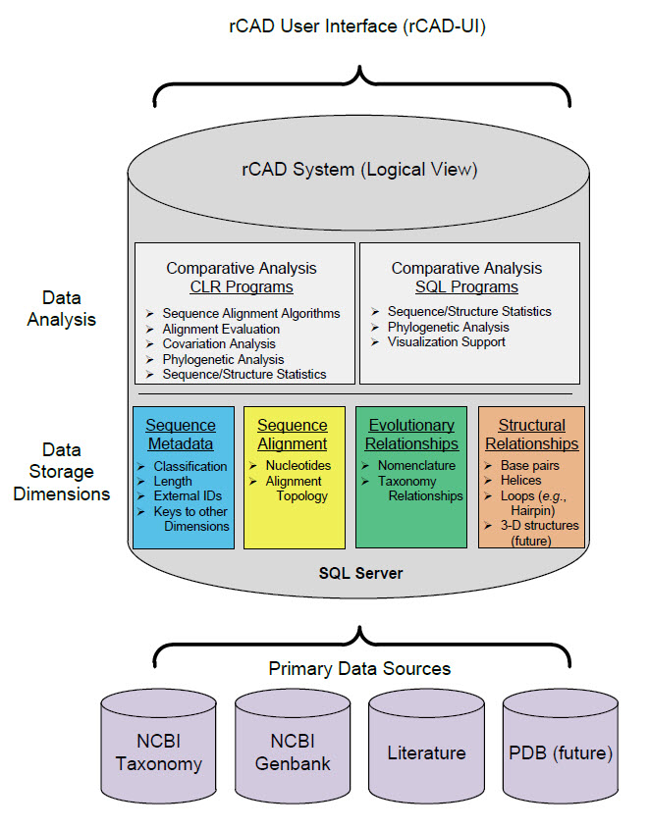
Data Management Re-architecture
rCAD: Multiple Dimensions of Data
CRW Web Site
External Data Source
Perl scripts and manual inspections.
External Analysis Software
MySQL Database
CAT
Alignment Editor
xRNA
RNA Table
Organism
Genus
Cell_location
Type
Seq_nbr
Site_positions
Seq_size
NCBI Table
Taxonomy
Name
Flat Sequence Files
Alignment Files
RNA Join Table
Common name
Accession Number
Alignment name
Structure
Structure Diagram
Files
Before
After
Do everything in the database “It’s the data, stupid” Jim Gray
Notes:
In the past, these information is stored in flat file (actually in modern days, that is the way a lot of biological database website used.
rCAD system (cooperate with microsoft research, SQL). Containing 4-dimension information.
The rCAD database cross-indexes 4 dimensions of RNA information including sequence, alignment, structure and phylogenetic/evolutionary information. The rCAD database is the first biological database system capable of storing sequence alignments down to the resolution of individual nucleotides. Individual rows, columns and cells in an alignment can be directly included in SQL statements along with different RNA structure and phylogenetic information.
Do all analysis in the database.
The schema of rCAD illustrating how the tables are cross-indexes by using these primary and foreign key.
By uniting multiple dimensions of information, rCAD allows new, innovative analyses of the fundamentals of RNA.
rCAD system provides a foundation (platform) for us to develop novel, innovative method to do the research.

Slide 18
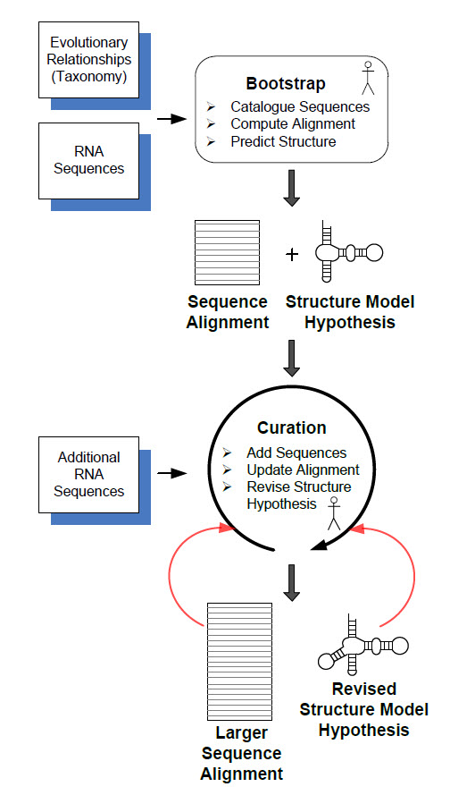
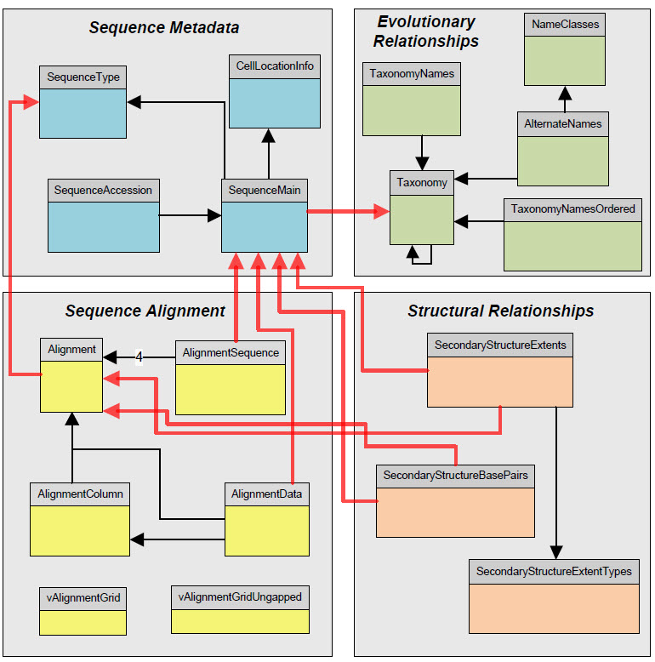
rCAD: Sophisticated Schema

Slide 19
Major Topics
RNA Science
Importance of RNA, major paradigm shift
RNA structure prediction and Comparative analysis
RNA Comparative Analysis Database (rCAD)
Multiple Dimensions of Data
Sophisticated Schema for data management and analysis
Discoveries and Applications possible with rCAD
Alignment editor
CRW Site
Enhanced covariation analysis with Phylogenetic Events Counting (PEC)
Improvements in the template-based alignment
Structural statistics that reveal biases in the distribution of sequences within different structural motifs.
Structural potentials that improve the prediction of an RNA secondary structure from a single sequence (RNA Folding).

Slide 20
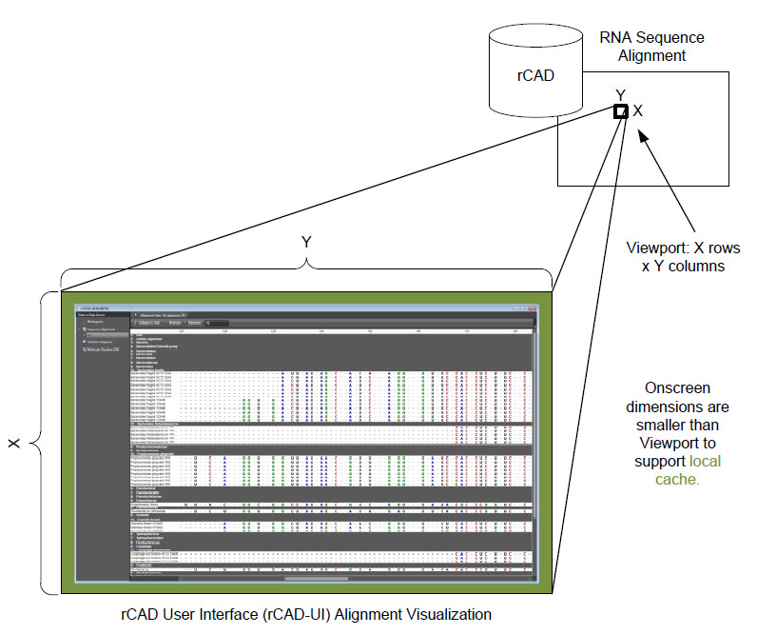
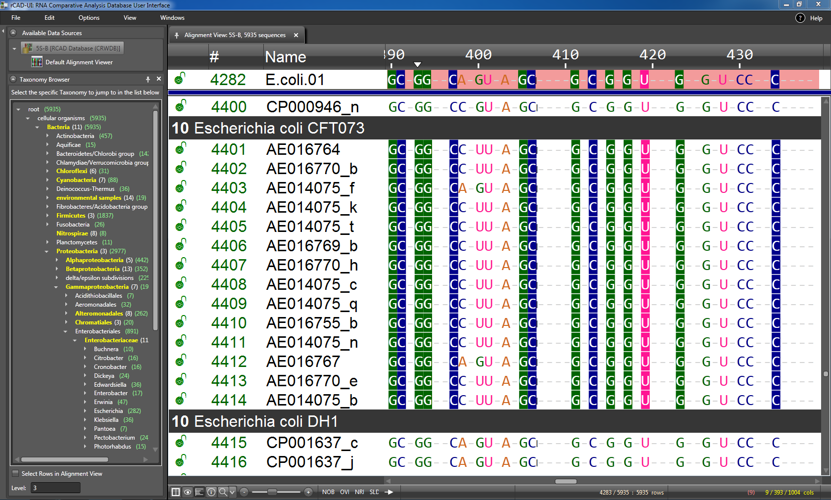
Discoveries and Applications: Alignment Editor

Slide 21
Discoveries and Applications: Alignment Editor

Slide 22
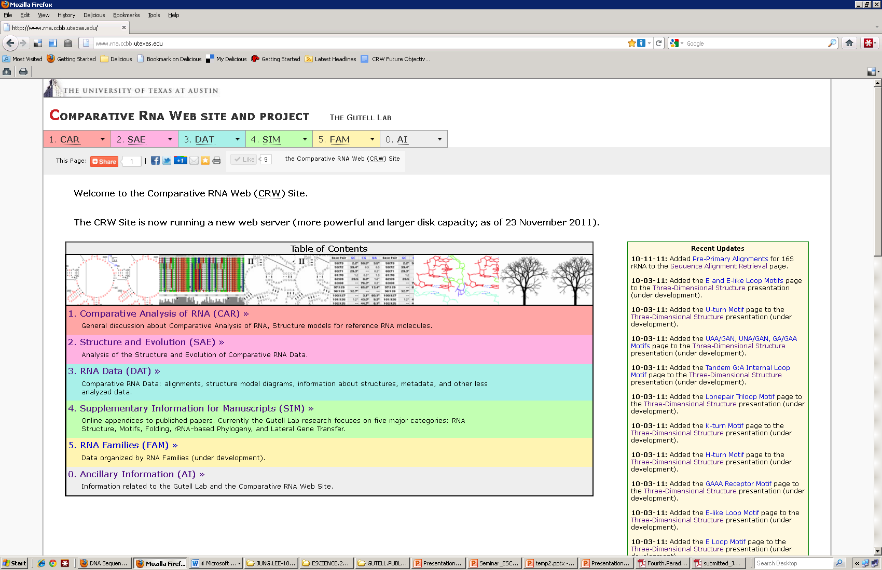
Discoveries and Applications: CRW site

Slide 23
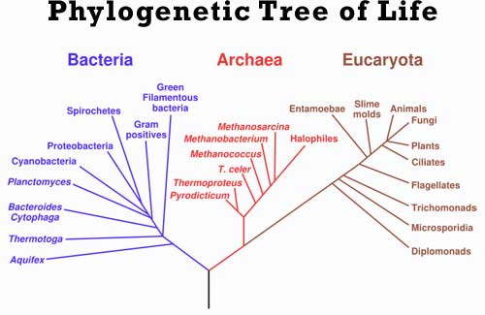
Discoveries and Applications: Phylogenetic Events Counting (PEC)
Phylogenetic tree of life
Base-pair Frequency Table
 |  | 5’ Nucleotide
 |  | A | C | G | U
3’ Nucleotide | A | 0 | 0 | 0 | 0
 | C | 0 | 0 | 33.3% | 0
 | G | 0 | 33.3% | 0 | 0
 | U | 33.3% | 0 | 0 | 0
GC + AU
Bacteria 33% G:C
Bacteria
11% G:C
11% A:U
11% C:G
GC + CG
AU + CG
Root
33% G:C
33% A:U
33% C:G
Archaea
33% C:G
Root
33% G:C
33% A:U
33% C:G
Archaea
11% G:C
11% A:U
11% C:G
GC
CG + AU
Eukaryota
33% A:U
GC
Eukaryota
11% G:C
11% A:U
11% C:G
CG
OR
AU
One Phylogenetic Event
Many Phylogenetic Events
Notes:
Early comparative analysis method depends on the statistical characteristics of each column in the alignment.
Can the evolutionary information of RNA enhance the identification of positional dependence and independence?
In some situation, MIXY can not distinguish between strong covariation and weak covariation.
Two extreme examples showing the difference.
So we need a with better solving power.

Slide 24
Discoveries and Applications: Phylogenetic Events Counting (PEC)

Slide 26
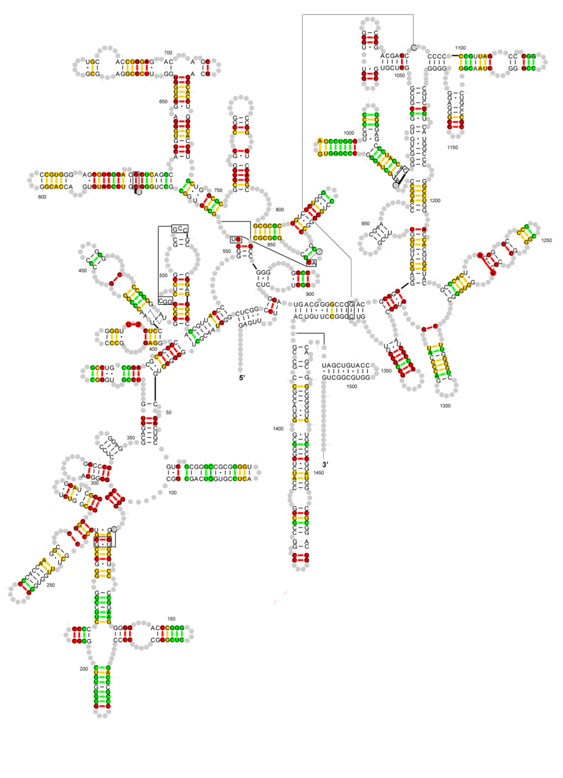
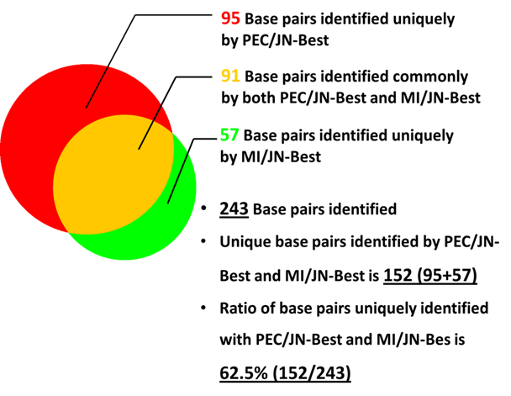
Discoveries and Applications: Phylogenetic Events Counting (PEC)

Slide 27
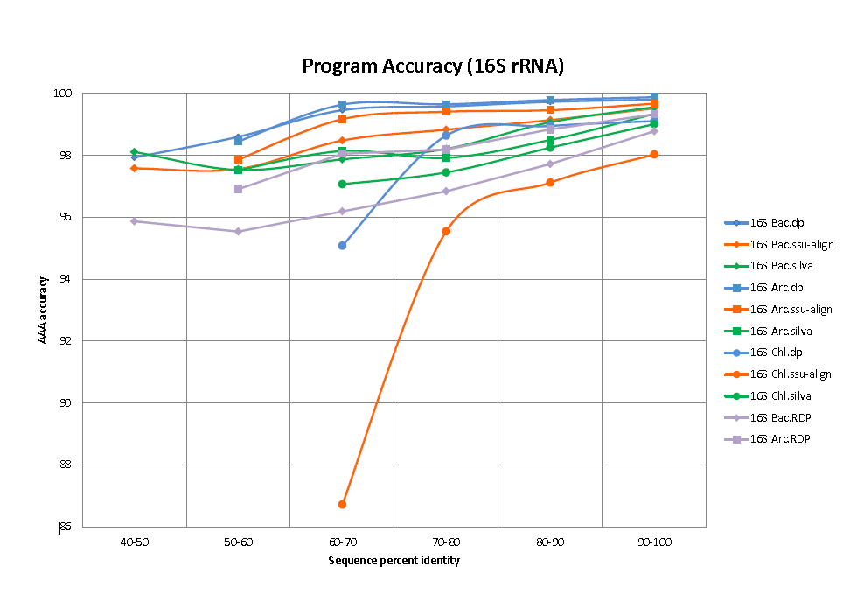
Discoveries and Applications: Template-based Alignment
While we are still improving the template-based alignment program, currently we are able to align > 30,000 sequences per week to an alignment that has > 200,000 Bacterial 16S rRNA sequences

Slide 28
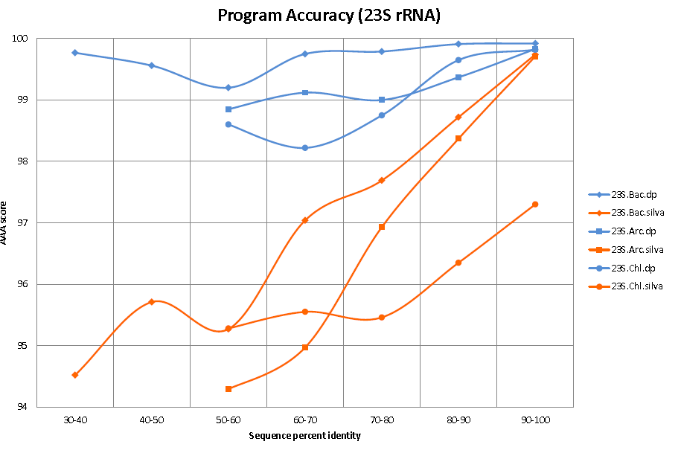
Discoveries and Applications: Template-based Alignment

Slide 29
Discoveries and Applications: Structural Statistics @CRW Site

Slide 30
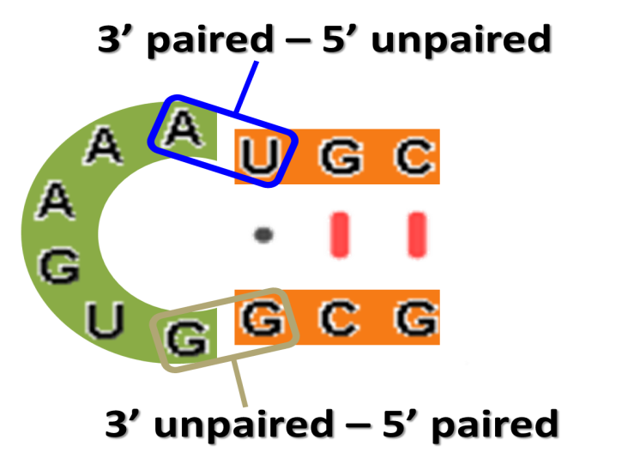
Discoveries and Applications: Structural Statistics @CRW Site

Slide 31
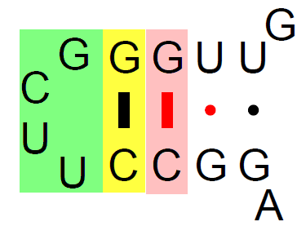
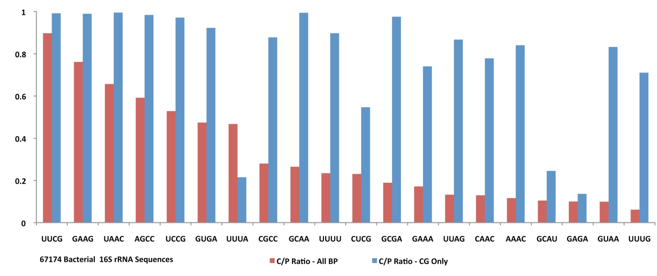
Discoveries and Applications: Structural Potentials / RNA Folding

Slide 32
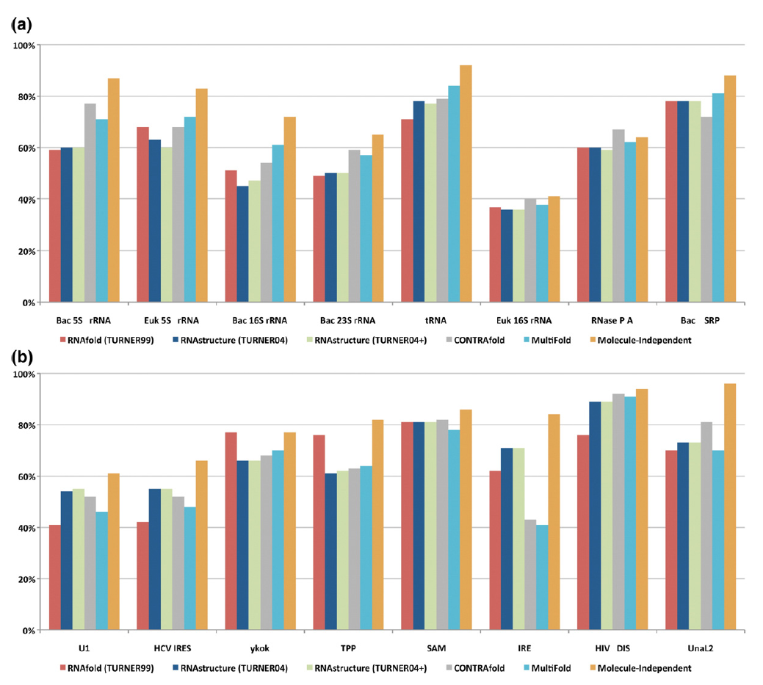
Discoveries and Applications: Structural Potentials / RNA Folding
Higher accuracy of RNA folding with Statistical Potentials

Slide 33
Research Team and Support
Team:
Robin Gutell (Principal/Principle Investigator)
Stuart Ozer (Microsoft; rCAD development)
Jamie Cannone (CRW Site/Project curator; rCAD development)
Lei Shang (Covariation analysis)
David Gardner (Structural statistics; RNA folding; rCAD development)
Jung Lee (RNA structure analysis)
Ame Wongsa (RNA2DMap development)
Kishore Doshi (rCAD development; RNA folding)
Funding:
National Institutes of Health
Microsoft Research (TCI/ER)
Welch Foundation
Notes:
Add roles for each person to this slide – let people read while you talk.

Slide 34
END

